Slide 1


Slide 2
Database Management Systems
Week 1, Day 1
Introduction to Database Systems
Atta Muhammad
+92-333-1971110
attapanhyar@quest.edu.pk

Slide 3

Course Overview
Goal: Enable students to be top 10% DBAs in the country
Topics:
1. What is a Database?
2. Differences between Database and File System
3. Roles of a Database Administrator (DBA)

Slide 4
What is a Database?
Definition:
A database is an organized collection of data stored electronically. It enables efficient storage, retrieval, and manipulation.

Slide 5
Key Features of a Database
Structured data storage
Efficient querying and retrieval
Data integrity and security
Scalability

Slide 6
Examples of Databases
Relational Databases (SQL Server, MySQL)
NoSQL Databases (MongoDB, Cassandra)
Cloud Databases (AWS RDS, Azure SQL)
Notes:
RDS-Relational Database Service

Slide 7

Database vs. File System
File System:
Lacks structure and relationships
Inefficient querying
Database:
Organized data
Supports relationships and complex queries

Slide 8

Database Example
E-Commerce System:
Customers Table
Orders Table
Products Table
Relations:
CustomerID in Orders relates to Customers Table.

Slide 9
Why Use Databases?
To manage large datasets efficiently
Ensure data accuracy and consistency
Enable multi-user access with security

Slide 10
Roles of a DBA
1. Database Design
2. Performance Tuning
3. Backup and Recovery
4. Security Management

Slide 11
Responsibilities of a DBA
Installing and configuring DBMS
Monitoring and optimizing performance
Managing access and ensuring security
Handling backups and disaster recovery

Slide 12

Skills Required for a DBA
SQL proficiency
Knowledge of RDBMS platforms
Problem-solving and analytical skills
Familiarity with performance tuning tools

Slide 13
What is an RDBMS?
Relational Database Management System:
A type of DBMS that stores data in tables with relationships defined through primary and foreign keys.

Slide 14
Examples of RDBMS
MySQL
PostgreSQL
Microsoft SQL Server
Oracle Database

Slide 15
Components of a Database
Tables: Store data
Indexes: Speed up queries
Views: Represent data subsets
Transactions: Ensure data integrity

Slide 16
Understanding Tables
Tables are made up of rows (records) and columns (attributes).
Example:
Customers Table:
- CustomerID
- CustomerName
- Email

Slide 17
Understanding Relationships
One-to-One
One-to-Many
Many-to-Many
Defined using Primary and Foreign Keys.

Slide 18
Normalization
A process to reduce redundancy and improve data integrity by organizing tables.
Forms:
1NF, 2NF, 3NF, BCNF

Slide 19
ACID Properties
1. Atomicity
2. Consistency
3. Isolation
4. Durability
Ensure reliable database transactions.

Slide 20
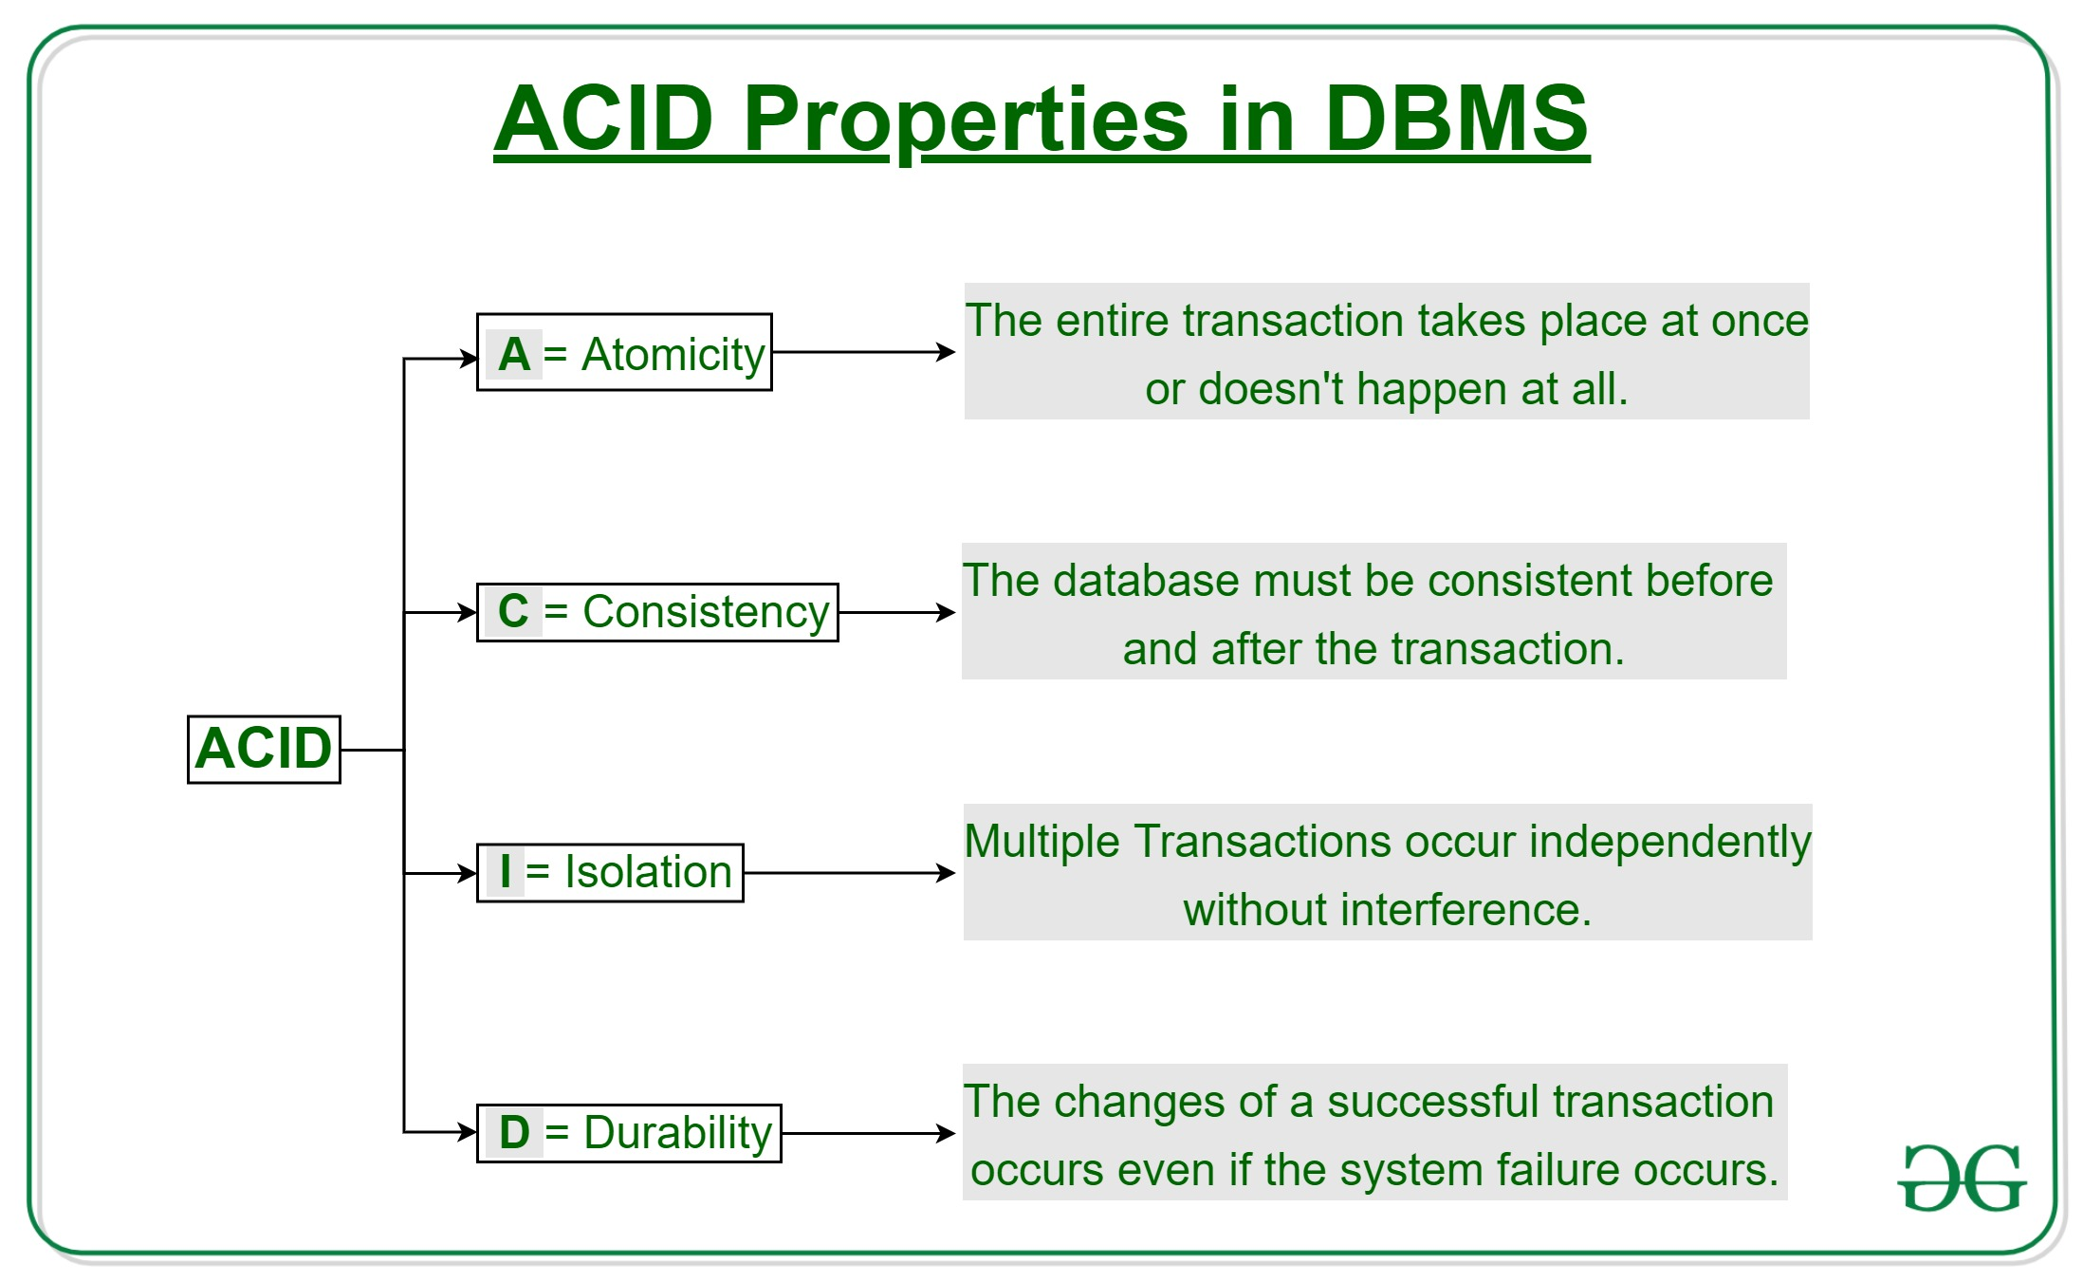
ACID Properties Details

Slide 21

DBMS Benefits
Data Integrity
Flexibility
Scalability
Security

Slide 22

Real-World Applications
1. Banking Systems
2. E-Commerce
3. Healthcare Records
4. Education Management Systems

Slide 23

Database Querying
SQL (Structured Query Language):
Standard for interacting with databases
CRUD operations (Create, Read, Update, Delete)

Slide 24
Introduction to SQL
SQL Commands:
1. SELECT: Retrieve data
2. INSERT: Add data
3. UPDATE: Modify data
4. DELETE: Remove data

Slide 25
Basic SQL Example
SELECT * FROM Customers;
Retrieves all rows from the Customers table.

Slide 26
Primary and Foreign Keys
Primary Key: Unique identifier for records.
Foreign Key: Links tables to enforce relationships.

Slide 27
Database Security
Role-based access control
Encryption
Regular audits and monitoring

Slide 28

Backup and Recovery
Why important?
Prevent data loss
Ensure business continuity
Techniques:
Full, Incremental, Differential backups.

Slide 29
DBMS Challenges
- Complexity
- High initial setup cost
- Requires skilled professionals

Slide 30

Future of Databases
Cloud Databases
NoSQL for Big Data
AI-Driven Database Management
Real-time Analytics

Slide 31

Course Expectations
Hands-on practice
Real-world case studies
Group projects and individual assessments

Slide 32

Closing Thoughts
Databases are the backbone of modern applications.
Mastery of DBMS concepts and SQL is crucial for IT professionals.

Slide 33
?(s)

